Slide 1
Region-guided Radiology Report Generation
Parsa Sharifi

Slide 2
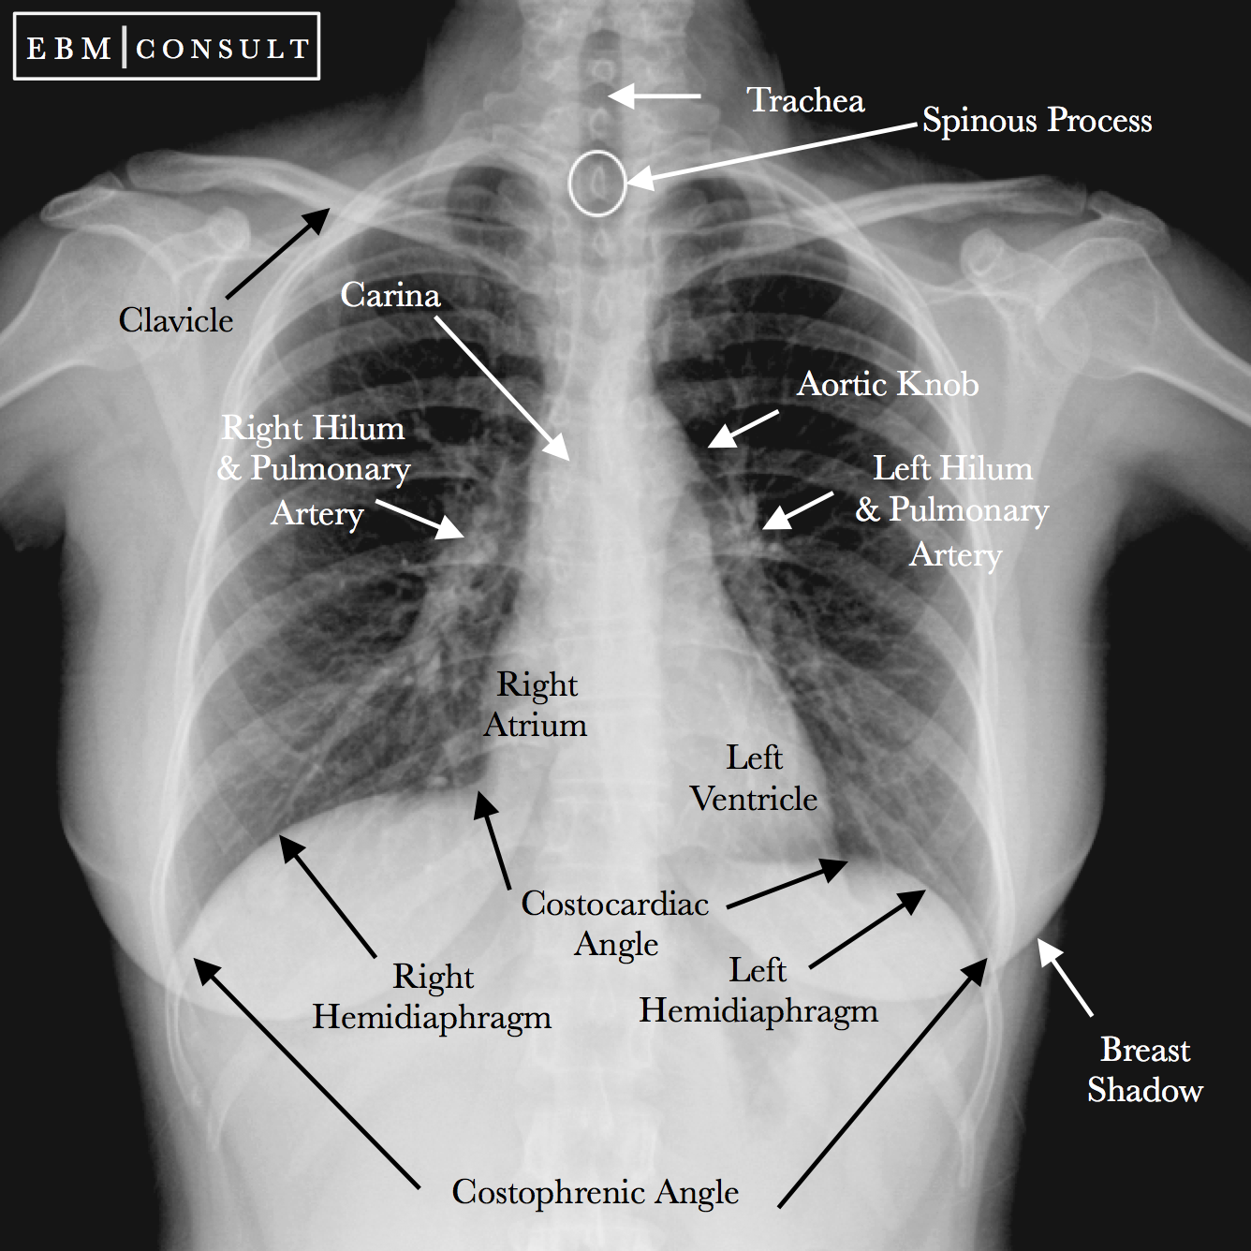
Chest radiography is widely used
Whole picture

Slide 3
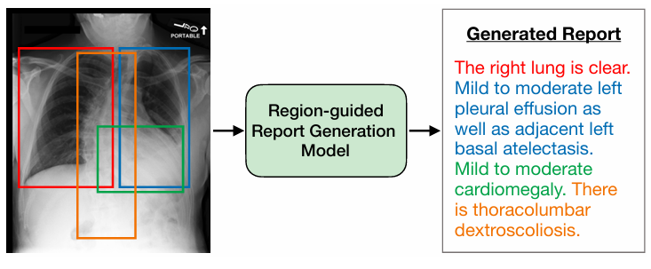
Region-Guided Radiology Report Generation (RGRG)
detects anatomical regions
generates individual descriptions

Slide 4
Method!

Slide 5
Pre-trained language model on anatomical region independently.
Anatomy-based sentence generate
Flexible use for radiologists
Selection-based

Slide 6
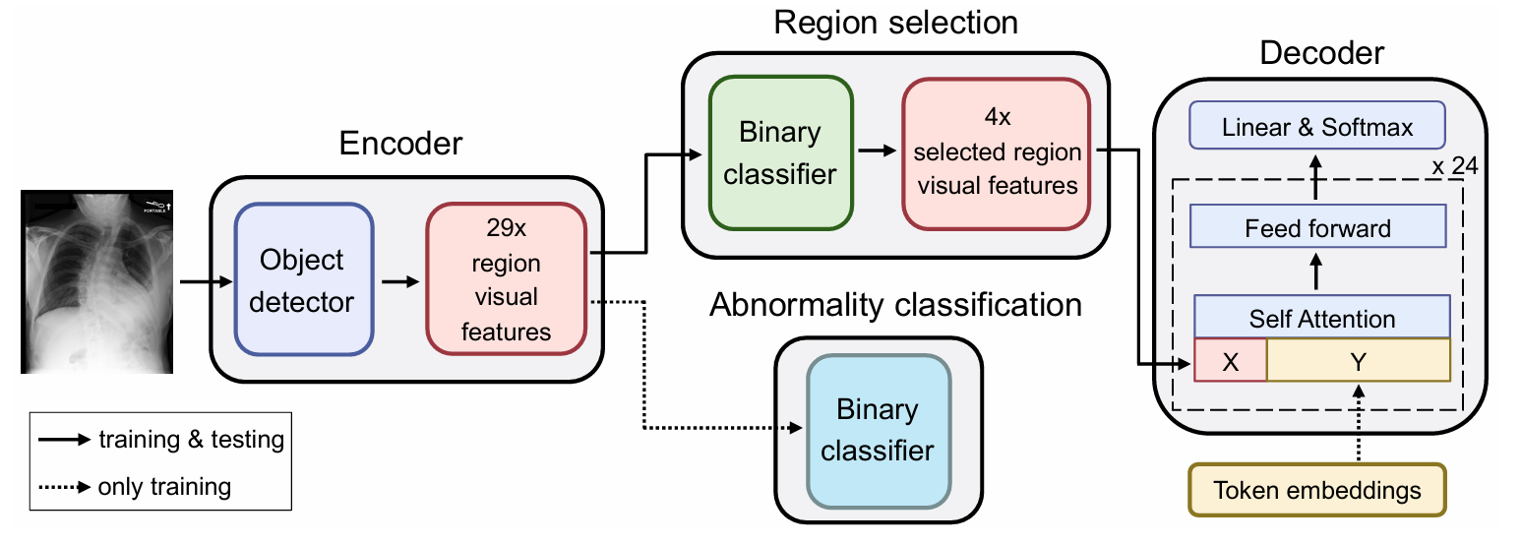

Slide 7
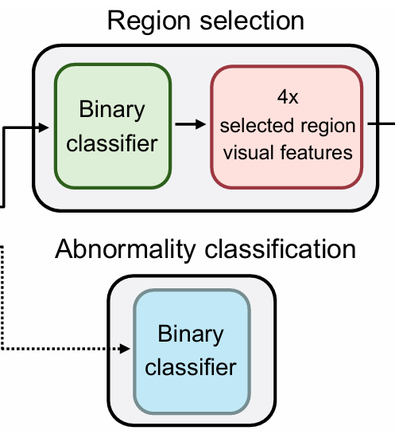
Object detector extracts features
For 29 unique anatomical regions
Binary classifiers select region

Slide 8
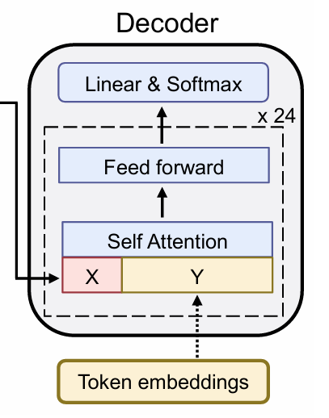
355M-parameter model GPT-2 Medium
Fine-tuned on PubMed abstracts
Based on self-attention

Slide 9

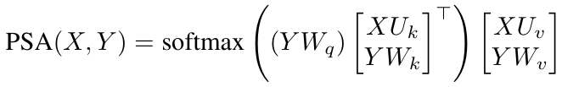

Slide 10
Y represents the token embedding
Wq, Wk, Wv are the query, key,
value projection
X is the region visual features
Uk and Uv are the corresponding (newly initialized) key and value projection parameters.

Slide 11
